Slide 1
Linear Regression Model ted talk
Aunchana Pimpisal
16 Dec’18

Slide 2

Ted talk
TED Conferences LLC (Technology, Entertainment, Design) is a media organization that posts talks online for free distribution under the slogan "ideas worth spreading."
TED events are also held throughout North America and in Europe and Asia, offering live streaming of the talks. They address a wide range of topics within the research and practice of science and culture, often through storytelling. The speakers are given a maximum of 18 minutes to present their ideas in the most innovative and engaging ways they can. TED Talks given by academics tend to be watched more online while art and design videos tend to be watched less than average.^{[20]}
Reference: https://en.wikipedia.org/wiki/TED_(conference)#TEDGlobal

Slide 3
Dataset :Ted talk
Reference: https://www.kaggle.com/rounakbanik/ted-talks

Slide 4
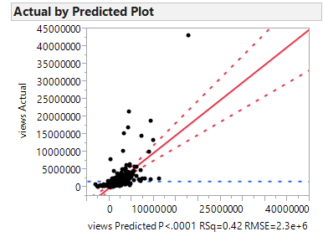
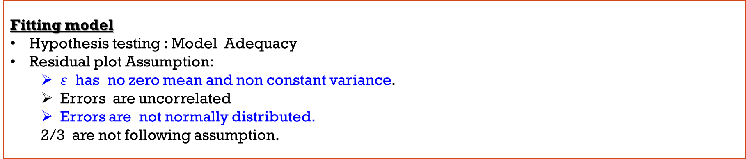
Model chart
Ted talk: Regressors Factor effect to views
Define Variable as respond (views) and Regressors (4 Quantitative and 9 Qualitative Variables)
Fitting model
Hypothesis testing : Model Adequacy
Residual plot Assumption:
$ε$ has no zero mean and non constant variance.
Errors are uncorrelated
Errors are not normally distributed.
2/3 are not following assumption.

Slide 5
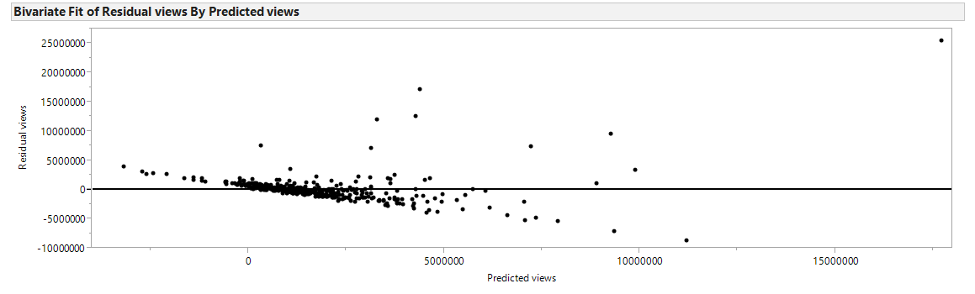
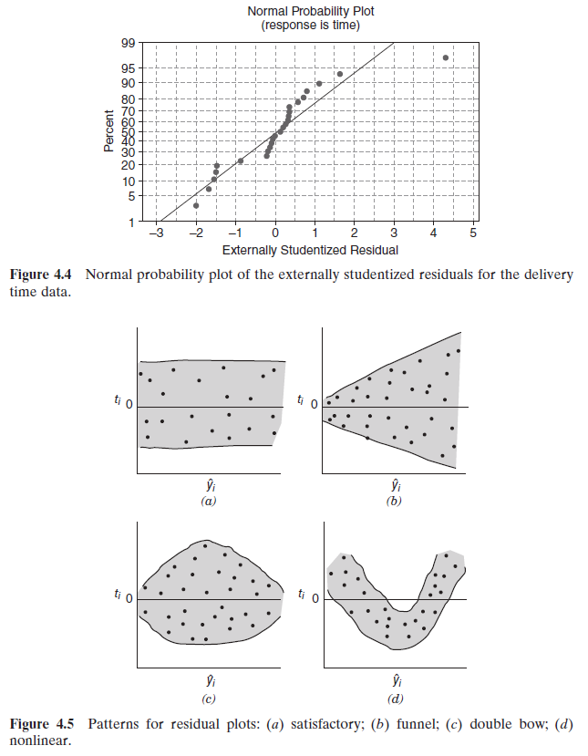
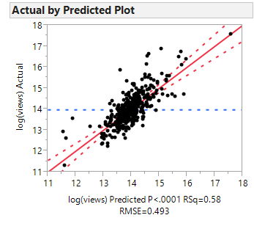


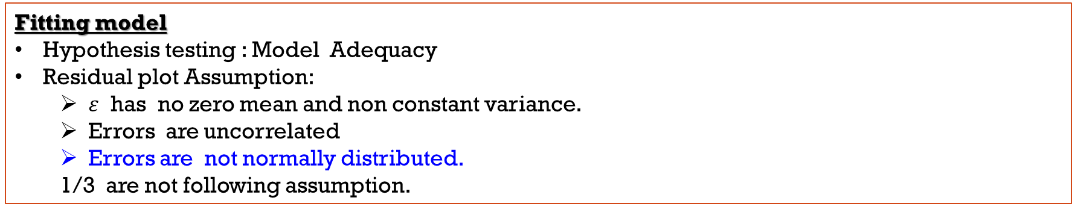
Model chart
Transformation
As Variance-stabilizing Transformations , transform Y into $Y^{′}=logY$ .
Stepwise : Fitting the model
Fitting model
Hypothesis testing : Model Adequacy
Residual plot Assumption:
$ε$ has no zero mean and non constant variance.
Errors are uncorrelated
Errors are not normally distributed.
1/3 are not following assumption.

Slide 6
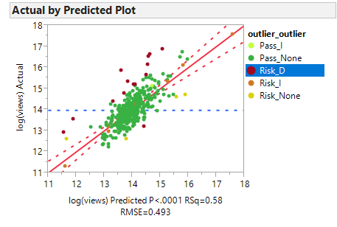
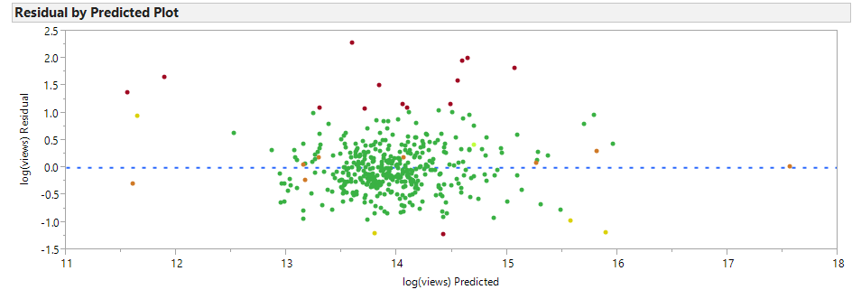
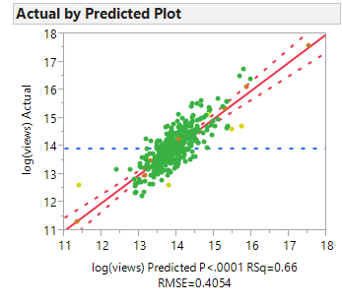
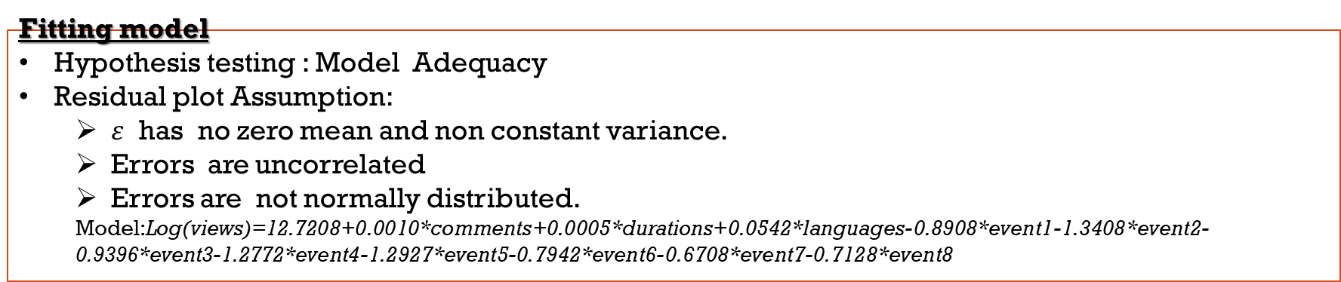
Model chart
Diagnostics for leverage and influence
cutting group “Risk” from R program and “Degrade mode” from Cov.r about 14 data point out.
Stepwise : Fitting the model
Fitting model
Hypothesis testing : Model Adequacy
Residual plot Assumption:
$ε$ has no zero mean and non constant variance.
Errors are uncorrelated
Errors are not normally distributed.
Model:Log(views)=12.7208+0.0010*comments+0.0005*durations+0.0542*languages-0.8908*event1-1.3408*event2-0.9396*event3-1.2772*event4-1.2927*event5-0.7942*event6-0.6708*event7-0.7128*event8

Slide 7
Ted talk: regressor Factor effect to views
Response:
Views => The number of views on the talk
Regressor :
4 Quantitative Variable
Comments => The number of comments made on the talk
Duration => The duration of the talk in seconds
num_speaker => The number of speakers in the talk
Languages => The number of languages in which the talk is available
9 Qualitative Variable
Event => The TED event where the talk took place
event | event1 | event2 | event3 | event4 | event5 | event6 | event7 | event8 | event9
TEDGlobal 2005 | 1 | 0 | 0 | 0 | 0 | 0 | 0 | 0 | 0 | if the observation is from TEDGlobal 2005
TEDGlobal 2007 | 0 | 1 | 0 | 0 | 0 | 0 | 0 | 0 | 0 | if the observation is from TEDGlobal 2007
TEDGlobal 2009 | 0 | 0 | 1 | 0 | 0 | 0 | 0 | 0 | 0 | if the observation is from TEDGlobal 2009
TEDGlobal 2010 | 0 | 0 | 0 | 1 | 0 | 0 | 0 | 0 | 0 | if the observation is from TEDGlobal 2010
TEDGlobal 2011 | 0 | 0 | 0 | 0 | 1 | 0 | 0 | 0 | 0 | if the observation is from TEDGlobal 2011
TEDGlobal 2012 | 0 | 0 | 0 | 0 | 0 | 1 | 0 | 0 | 0 | if the observation is from TEDGlobal 2012
TEDGlobal 2013 | 0 | 0 | 0 | 0 | 0 | 0 | 1 | 0 | 0 | if the observation is from TEDGlobal 2013
TEDGlobal 2014 | 0 | 0 | 0 | 0 | 0 | 0 | 0 | 1 | 0 | if the observation is from TEDGlobal 2014
TEDGlobal 2017 | 0 | 0 | 0 | 0 | 0 | 0 | 0 | 0 | 0 | if the observation is from TEDGlobal 2017

Slide 8
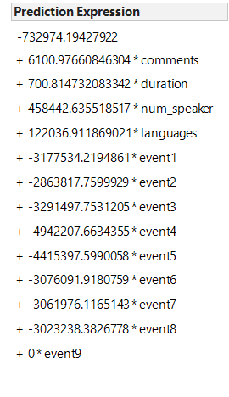
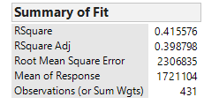
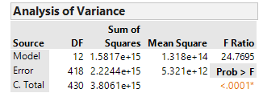
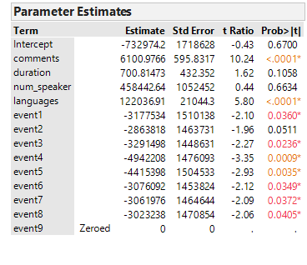
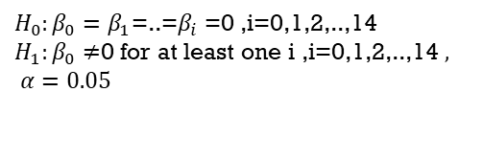
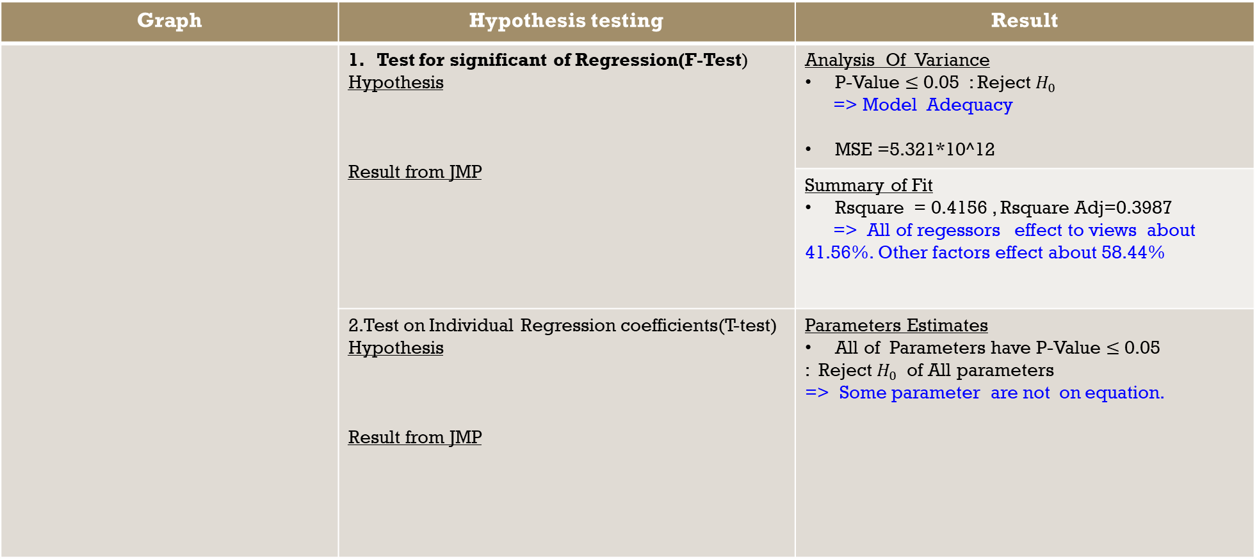
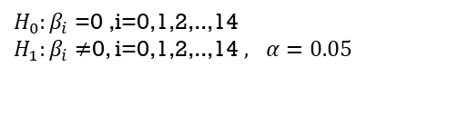
MoDel: Hypothesis testing
Prediction Expression :
Graph | Hypothesis testing | Result
 | 1. Test for significant of Regression(F-Test) Hypothesis Result from JMP | Analysis Of Variance P-Value $≤$ 0.05 : Reject $H_{0}$ => Model Adequacy MSE =5.321*10^12
 |  | Summary of Fit Rsquare = 0.4156 , Rsquare Adj=0.3987 => All of regessors effect to views about 41.56%. Other factors effect about 58.44%
 | 2.Test on Individual Regression coefficients(T-test) Hypothesis Result from JMP | Parameters Estimates All of Parameters have P-Value $≤$ 0.05 : Reject $H_{0}$ of All parameters => Some parameter are not on equation.
$H_{0}:β_{0}=β_{1}$=..=$β_{i}$ =0 ,i=0,1,2,..,14
$H_{1}:β_{0}≠$0 for at least one i ,i=0,1,2,..,14$, α=0.05$
$H_{0}:β_{i}$ =0 ,i=0,1,2,..,14
$H_{1}:β_{i}≠$0, i=0,1,2,..,14$, α=0.05$

Slide 9
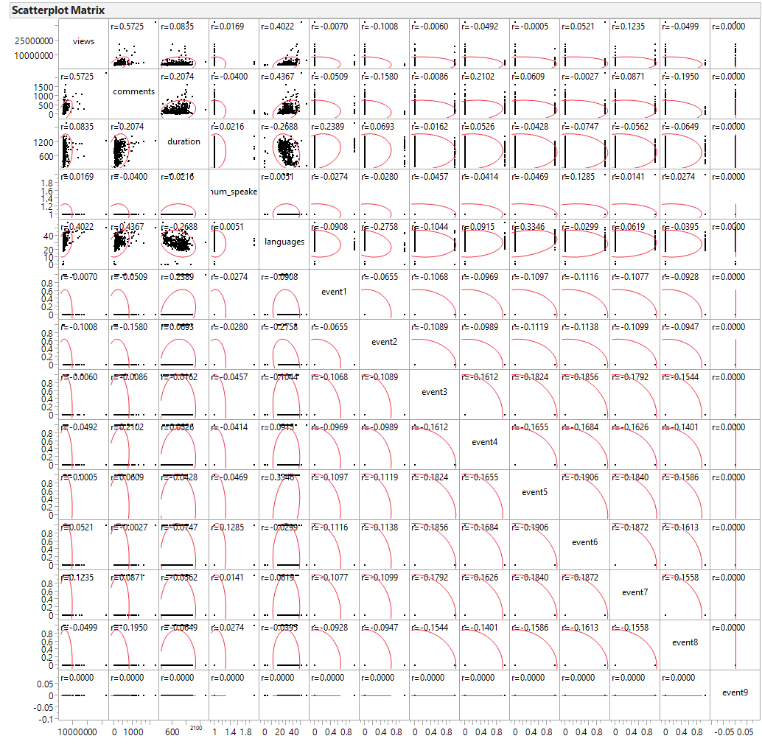
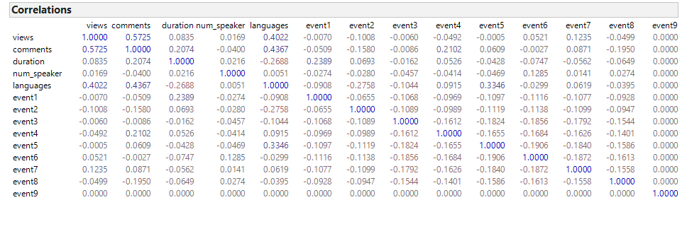
MoDel : Matrix Scatter plot
Result Matrix Scatter plot as correlation
The number of views is correlated with the number of comments about 0.5725.
Other correlation each variable are not mare than 0.5

Slide 10
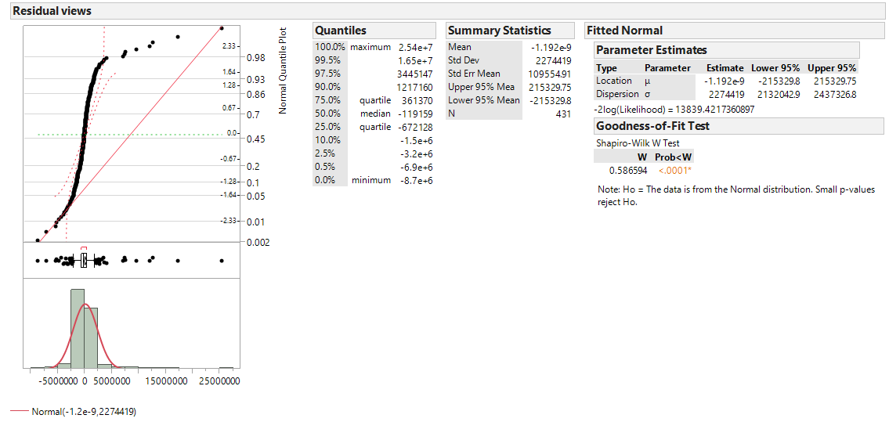
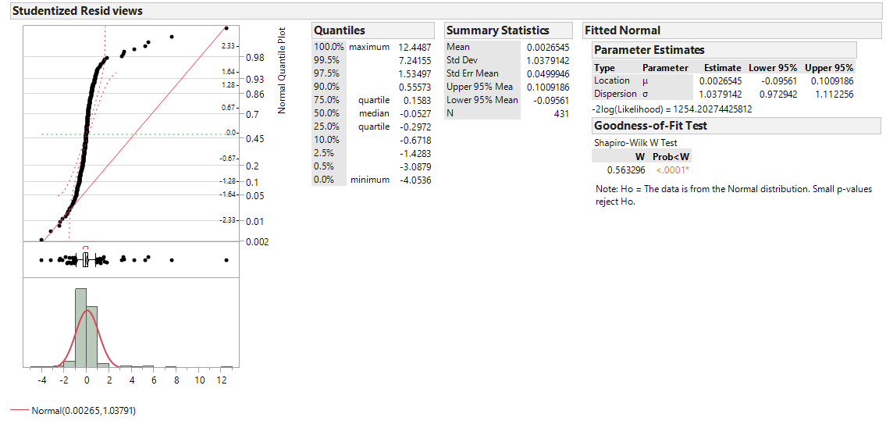
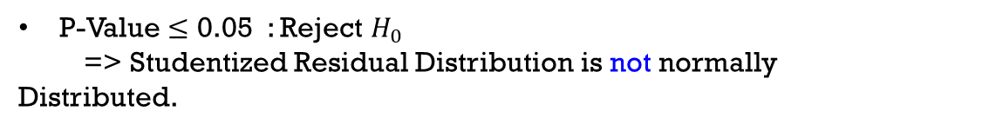
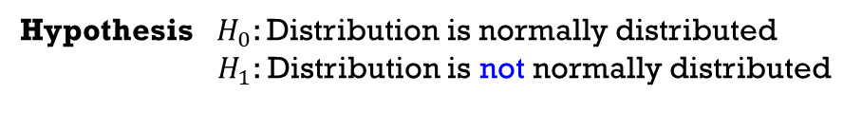
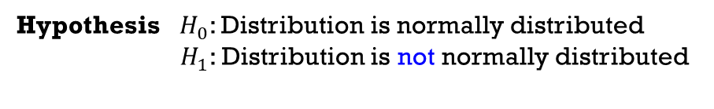
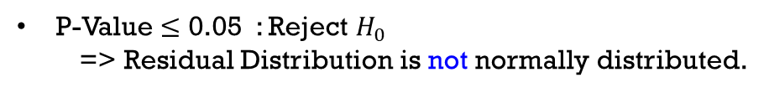
Residual plot
Normal Probability plot of Residual => Check the normality assumption
Result : Residual Distribution and Studentized Residual Distribution are not normally distributed.
Residual
Studentized Residual
Hypothesis $H_{0}$: Distribution is normally distributed
$H_{1}$: Distribution is not normally distributed
Hypothesis $H_{0}$: Distribution is normally distributed
$H_{1}$: Distribution is not normally distributed
P-Value $≤$ 0.05 : Reject $H_{0}$
=> Residual Distribution is not normally distributed.
P-Value $≤$ 0.05 : Reject $H_{0}$
=> Studentized Residual Distribution is not normally
Distributed.

Slide 11
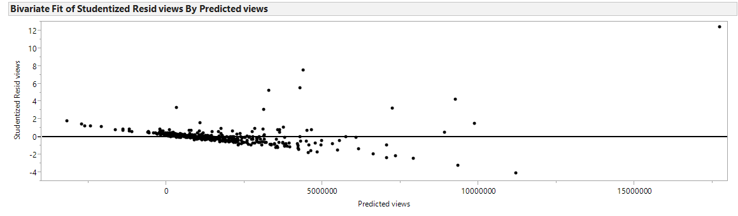
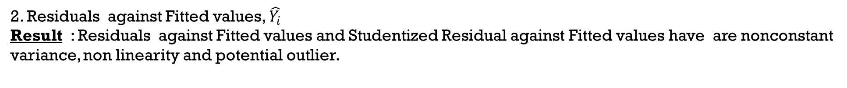
Residual plot
2. Residuals against Fitted values, $\hat{Y_{i}}$
Result : Residuals against Fitted values and Studentized Residual against Fitted values have are nonconstant variance, non linearity and potential outlier.
Residual
Studentized Residual
Checking for | Residual | Studentized Residual
Non constant variance | Yes | Yes
Non linearity | Yes | Yes
Potential outlier | Yes | Yes

Slide 12
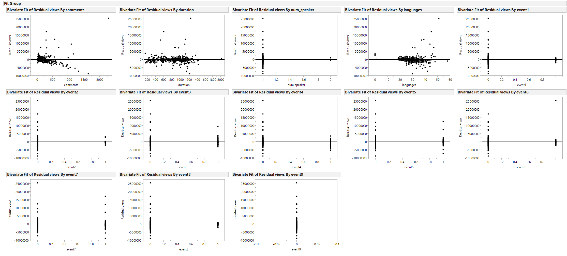
Residual plot
3. Residuals against Regressors in the model
Result : Comments , durations and languages that are quantitative Variable are non constant variance and non linearity. But num_speaker is constant variance and linearity.
.
Checking for | comments | durations | num_speaker | language
Non constant variance | Yes | Yes | No | Yes
Non linearity | Yes | Yes | No | Yes

Slide 13
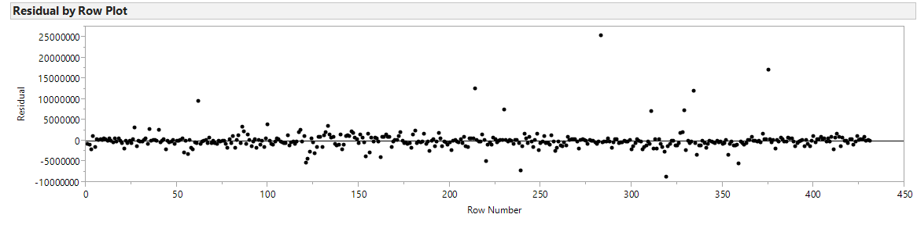
Residual plot ?
4. Residuals against Time order => check for Correlate errors
Result : Residuals are uncorrelated.

Slide 14
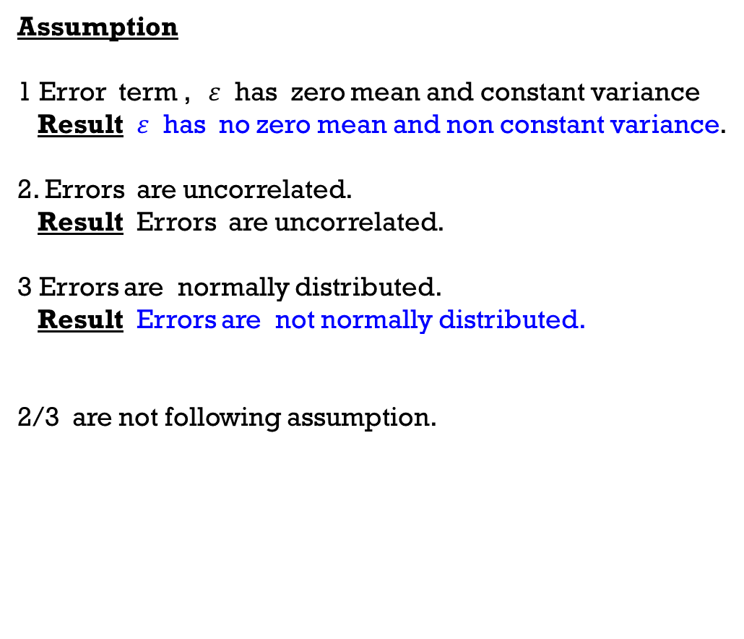
Residual plot summary
Assumption
1 Error term , $ε$ has zero mean and constant variance
Result $ε$ has no zero mean and non constant variance.
2. Errors are uncorrelated.
Result Errors are uncorrelated.
3 Errors are normally distributed.
Result Errors are not normally distributed.
2/3 are not following assumption.
So, Going to Transformation !!!!!!!!!!!!!!!!!!

Slide 15
Transformation

Slide 16
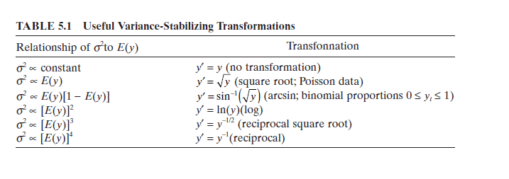
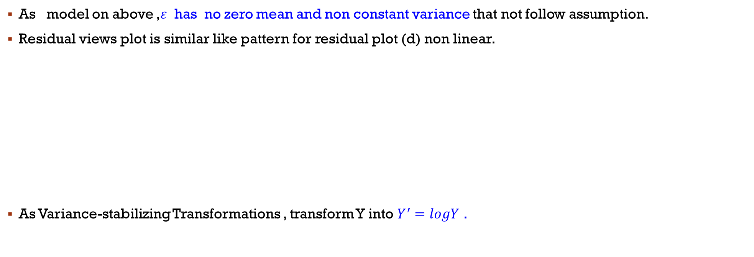
Parameter Transformation
As model on above ,$ε$ has no zero mean and non constant variance that not follow assumption.
Residual views plot is similar like pattern for residual plot (d) non linear.
As Variance-stabilizing Transformations , transform Y into $Y^{′}=logY$ .

Slide 17
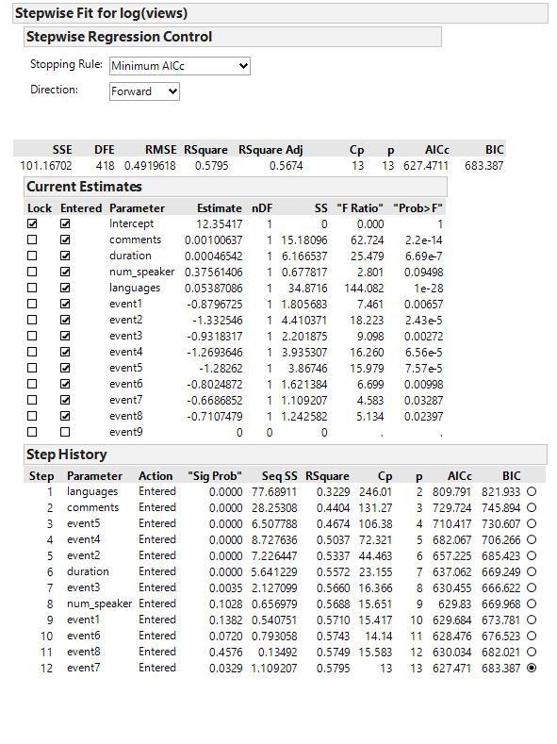
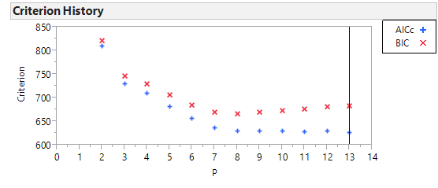
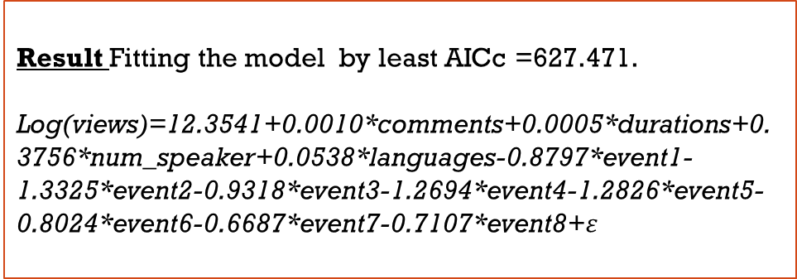
Stepwise : Fitting the model
Result Fitting the model by least AICc =627.471.
Log(views)=12.3541+0.0010*comments+0.0005*durations+0.3756*num_speaker+0.0538*languages-0.8797*event1-1.3325*event2-0.9318*event3-1.2694*event4-1.2826*event5-0.8024*event6-0.6687*event7-0.7107*event8+$ε$

Slide 18
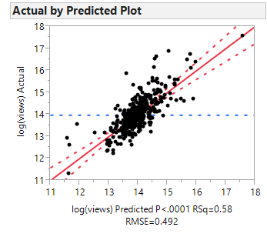
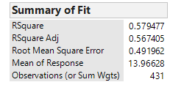
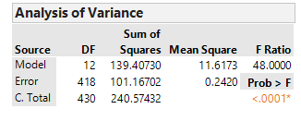
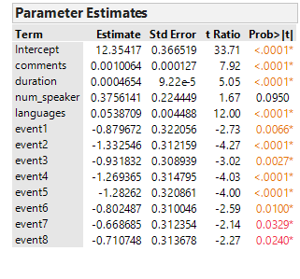
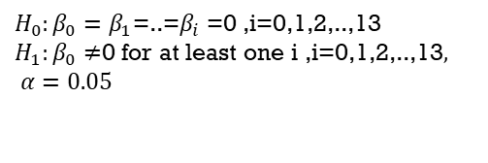
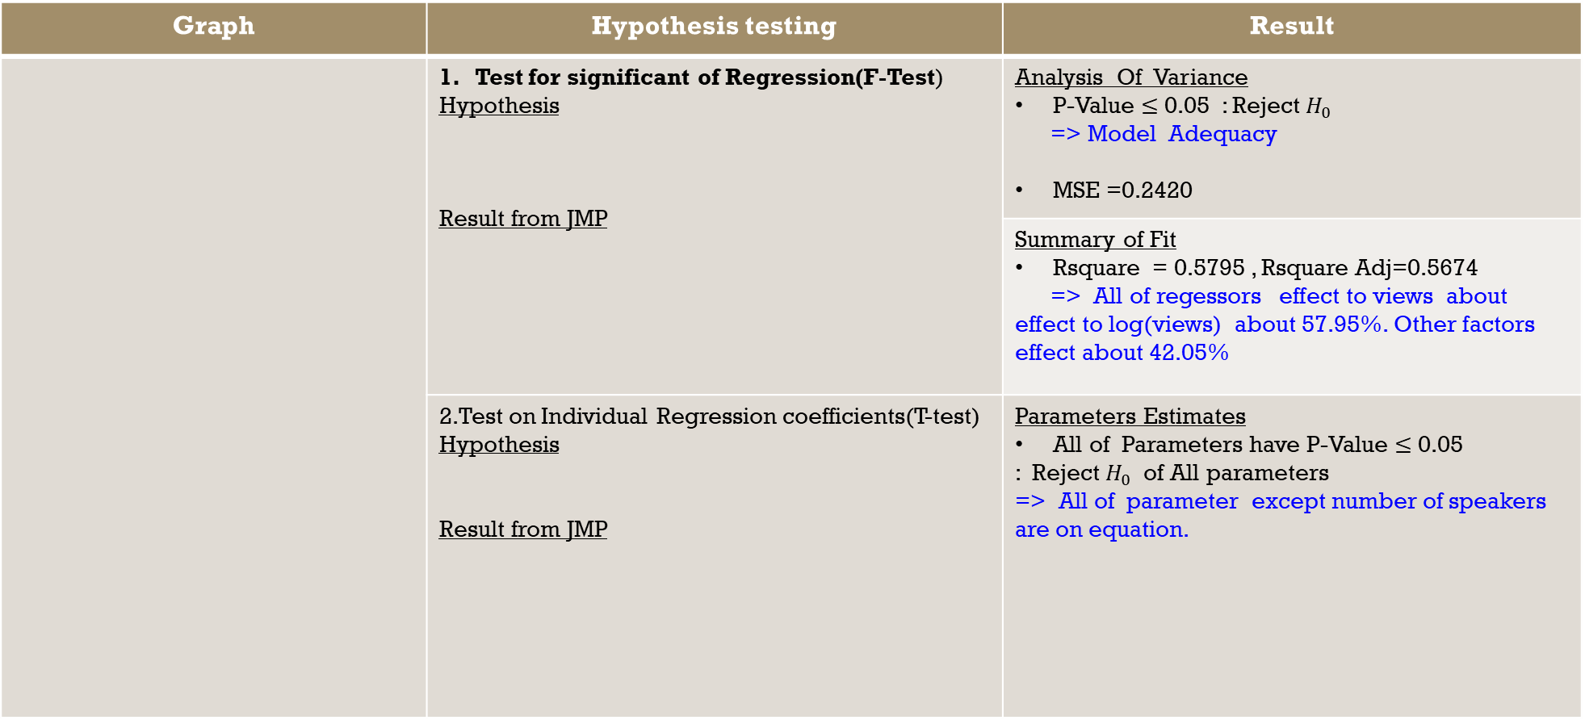
MoDel: Hypothesis testing
Prediction Expression :
Log(views)=12.3541+0.0010*comments+0.0005*durations+0.3756*num_speaker+0.0538*languages-0.8797*event1-1.3325*event2-0.9318*event3-1.2694*event4-1.2826*event5-0.8024*event6-0.6687*event7-0.7107*event8
Graph | Hypothesis testing | Result
 | 1. Test for significant of Regression(F-Test) Hypothesis Result from JMP | Analysis Of Variance P-Value $≤$ 0.05 : Reject $H_{0}$ => Model Adequacy MSE =0.2420
 |  | Summary of Fit Rsquare = 0.5795 , Rsquare Adj=0.5674 => All of regessors effect to views about effect to log(views) about 57.95%. Other factors effect about 42.05%
 | 2.Test on Individual Regression coefficients(T-test) Hypothesis Result from JMP | Parameters Estimates All of Parameters have P-Value $≤$ 0.05 : Reject $H_{0}$ of All parameters => All of parameter except number of speakers are on equation.
$H_{0}:β_{0}=β_{1}$=..=$β_{i}$ =0 ,i=0,1,2,..,13
$H_{1}:β_{0}≠$0 for at least one i ,i=0,1,2,..,13$, α=0.05$
$H_{0}:β_{i}$ =0 ,i=0,1,2,..,14
$H_{1}:β_{i}≠$0, i=0,1,2,..,14$, α=0.05$

Slide 19
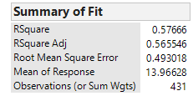
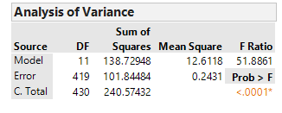
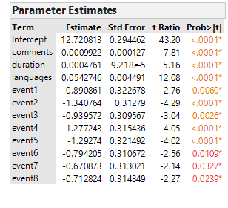
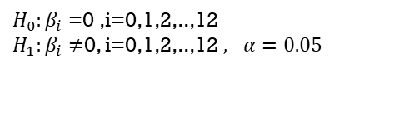
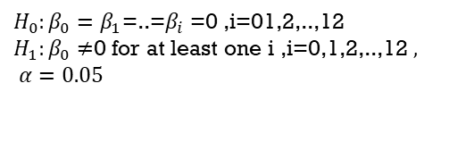
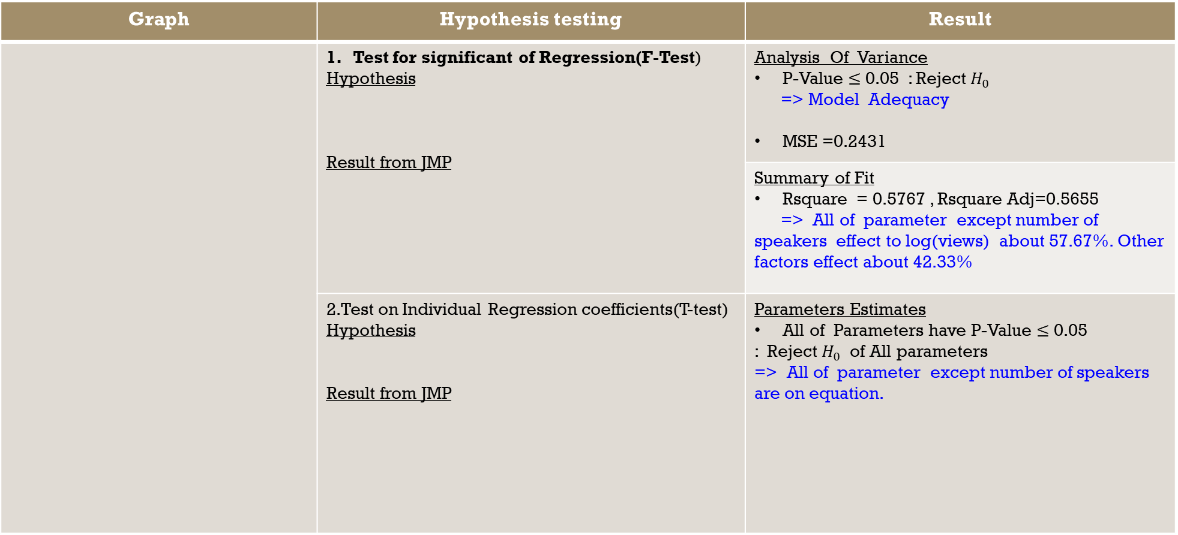
MoDel
Prediction Expression :
Log(views)=12.7208+0.0001*comments+0.0005*durations+0.0542*languages-0.8909*event1-1.3408*event2-0.9396*event3-1.2772*event4-1.2927*event5-0.7942*event6-0.6709*event7-0.7128*event8
Graph | Hypothesis testing | Result
 | 1. Test for significant of Regression(F-Test) Hypothesis Result from JMP | Analysis Of Variance P-Value $≤$ 0.05 : Reject $H_{0}$ => Model Adequacy MSE =0.2431
 |  | Summary of Fit Rsquare = 0.5767 , Rsquare Adj=0.5655 => All of parameter except number of speakers effect to log(views) about 57.67%. Other factors effect about 42.33%
 | 2.Test on Individual Regression coefficients(T-test) Hypothesis Result from JMP | Parameters Estimates All of Parameters have P-Value $≤$ 0.05 : Reject $H_{0}$ of All parameters => All of parameter except number of speakers are on equation.
$H_{0}:β_{0}=β_{1}$=..=$β_{i}$ =0 ,i=01,2,..,12
$H_{1}:β_{0}≠$0 for at least one i ,i=0,1,2,..,12$, α=0.05$
$H_{0}:β_{i}$ =0 ,i=0,1,2,..,12
$H_{1}:β_{i}≠$0, i=0,1,2,..,12$, α=0.05$

Slide 20
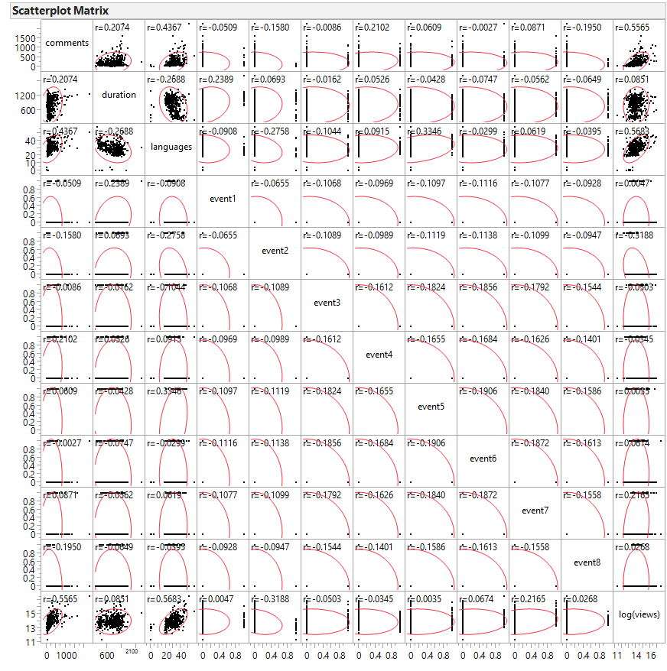
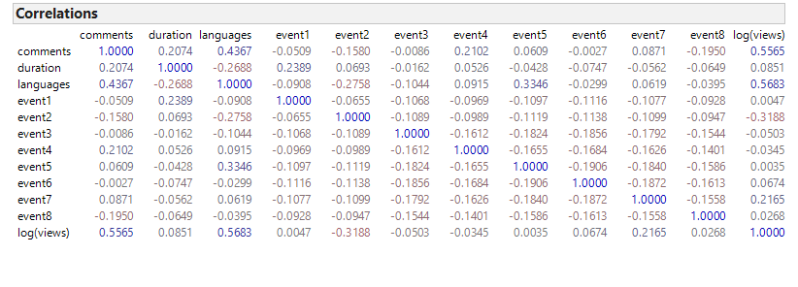
MoDel : Matrix Scatter plot
Result Matrix Scatter plot as correlation
Log(views) are correlated with the number of comments about 0.5565 and the number of languages about 0.5683.
Other correlation each variable are not mare than 0.5

Slide 21
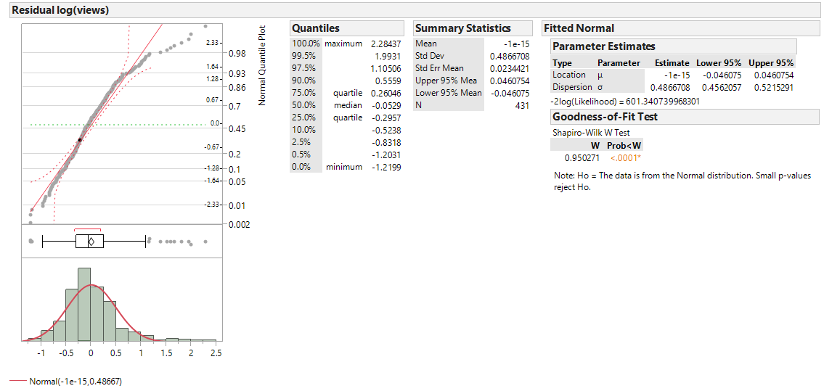

Residual plot
Normal Probability plot of Residual => Check the normality assumption
Result : Residual Distribution and Studentized Residual Distribution are not normally distributed.
Residual
Studentized Residual
Hypothesis $H_{0}$: Distribution is normally distributed
$H_{1}$: Distribution is not normally distributed
Hypothesis $H_{0}$: Distribution is normally distributed
$H_{1}$: Distribution is not normally distributed
P-Value $≤$ 0.05 : Reject $H_{0}$
=> Residual Distribution is not normally distributed.
P-Value $≤$ 0.05 : Reject $H_{0}$
=> Studentized Residual Distribution is not normally
Distributed.

Slide 22



Residual plot
2. Residuals against Fitted values, $\hat{Y_{i}}$
Result : Residuals against Fitted values and Studentized Residual against Fitted values are constant variance,
linearity and potential outlier.
Residual
Studentized Residual
Checking for | Residual | Studentized Residual
Non constant variance | No | No
Non linearity | No | No
Potential outlier | Yes | Yes

Slide 23

Residual plot
3. Residuals against Regressors in the model
Result : Comments , durations and languages that are quantitative Variable are constant variance and linearity.
Checking for | comments | durations | language
Non constant variance | No | No | No
Non linearity | No | No | No

Slide 24

Residual plot ?
4. Residuals against Regressors are not in the model
If a pattern appears, could indicate that adding regressor might improve the model fit
Result : num_speaker are constant variance and linearity. Don’t have pattern, so no improve model.

Slide 25

Residual plot ?
5. Residuals against Time order => check for Correlate errors
Result : Residuals are uncorrelated.

Slide 26

Residual plot summary
Assumption
1 Error term , $ε$ has zero mean and constant variance
Result $ε$ has zero mean and constant variance.
2. Errors are uncorrelated.
Result Errors are uncorrelated.
3 Errors are normally distributed.
Result Errors are not normally distributed.
1/3 are not following assumption.
So, Going to diagnostics for leverage and influence !!!!!!!!!!!!!!!!!!

Slide 27
diagnostics for leverage and influence

Slide 28

Diagnostics for leverage and influence
Result: cutting group “Risk” and “Degrade mode” about 14 data point out.
Separate into 2 group by R program as
“*”= Risk and “ “ = Pass
and also cut off criteria by Cov.r as
“I” =improve model (1+3p/n)
“D” =Degrade model(1-3p/n)

Slide 29
Diagnostics for leverage and influence

Slide 30

Stepwise : Fitting the model
Result Fitting the model by least AICc =445.174.
Log(views)=12.7208+0.0010*comments+0.0005*durations+0.0542*languages-0.8908*event1-1.3408*event2-0.9396*event3-1.2772*event4-1.2927*event5-0.7942*event6-0.6708*event7-0.7128*event8

Slide 31






MoDel :Hypothesis testing
Prediction Expression :
Log(views)=12.7208+0.0010*comments+0.0005*durations+0.0542*languages-0.8908*event1-1.3408*event2-0.9396*event3-1.2772*event4-1.2927*event5-0.7942*event6-0.6708*event7-0.7128*event8
Graph | Hypothesis testing | Result
 | 1. Test for significant of Regression(F-Test) Hypothesis Result from JMP | Analysis Of Variance P-Value $≤$ 0.05 : Reject $H_{0}$ => Model Adequacy MSE =0.1644
 |  | Summary of Fit Rsquare = 0.6650 , Rsquare Adj=0.6559 => All of parameter except number of speakers effect to log(views) about 66.50%. Other factors effect about 33.50%
 | 2.Test on Individual Regression coefficients(T-test) Hypothesis Result from JMP | Parameters Estimates All of Parameters have P-Value $≤$ 0.05 : Reject $H_{0}$ of All parameters => All of parameter except number of speakers are on equation.
$H_{0}:β_{0}=β_{1}$=..=$β_{i}$ =0 ,i=0,1,2,..,12
$H_{1}:β_{0}≠$0 for at least one i ,i=0,1,2,..,12$, α=0.05$
$H_{0}:β_{i}$ =0 ,i=0,1,2,..,12
$H_{1}:β_{i}≠$0, i=0,1,2,..,1$2 , α=0.05$

Slide 32


MoDel : Matrix Scatter plot
Result Matrix Scatter plot as correlation
Log(views) are correlated with the number of comments about 0.5943 and the number of languages about 0.5843.
Other correlation each variable are not mare than 0.5

Slide 33




Residual plot
Normal Probability plot of Residual => Check the normality assumption
Result : Residual Distribution and Studentized Residual Distribution are normally distributed.
Residual
Studentized Residual
Hypothesis $H_{0}$: Distribution is normally distributed
$H_{1}$: Distribution is not normally distributed
Hypothesis $H_{0}$: Distribution is normally distributed
$H_{1}$: Distribution is not normally distributed
P-Value > 0.05 : Not Reject $H_{0}$
=> Residual Distribution is normally distributed.
P-Value > 0.05 : Not Reject $H_{0}$
=> Studentized Residual Distribution is normally
Distributed.

Slide 34



Residual plot
2. Residuals against Fitted values, $\hat{Y_{i}}$
Result : Residuals against Fitted values and Studentized Residual against Fitted values are constant variance,
linearity and potential outlier but accept to improve model.
Residual
Studentized Residual
Checking for | Residual | Studentized Residual
Non constant variance | No | No
Non linearity | No | No
Potential outlier | Yes. but accept to improve model | Yes. but accept to improve model

Slide 35

Residual plot
3. Residuals against Regressors in the model
Result : Comments and languages that are quantitative Variable are non constant variance and non linearity.
Event4 and event5 are dummy variable. So, They are constant variance and linearity.
Checking for | comments | durations | language
Non constant variance | No | No | No
Non linearity | No | No | No

Slide 36

Residual plot ?
4. Residuals against Regressors are not in the model
If a pattern appears, could indicate that adding regressor might improve the model fit
Result : Comments and languages that are quantitative Variable are non constant variance and non linearity.
Event4 and event5 are dummy variable. So, They are constant variance and linearity.

Slide 37

Residual plot (wrong) check by hypothesis that dependent or not?
5. Residuals against Time order => check for Correlate errors
Result : Residuals are uncorrelated.

Slide 38

Residual plot summary
Assumption
1 Error term , $ε$ has zero mean and constant variance
Result $ε$ has zero mean and constant variance.
2. Errors are uncorrelated.
Result Errors are uncorrelated.
3 Errors are normally distributed.
Result Errors are normally distributed.
All are following assumption.
So, Model !!!!!!!!!!!!!!!!!!
Log(views)=12.7208+0.0010*comments+0.0005*durations+0.0542*languages-0.8908*event1-1.3408*event2-0.9396*event3-1.2772*event4-1.2927*event5-0.7942*event6-0.6708*event7-0.7128*event8

Slide 39

Summary
Model that effect to views in linear Regression model is
Log(views)=12.7208+0.0010*comments+0.0005*durations+0.0542*languages-0.8908*event1-1.3408*event2-0.9396*event3-1.2772*event4-1.2927*event5-0.7942*event6-0.6708*event7-0.7128*event8
By the number of comments , the duration of talk in second, the number of language that available , Event: TEDGlobal 2005, Event: TEDGlobal 2009, Event: TEDGlobal 2010, Event: TEDGlobal 2011, Event: TEDGlobal 2012, Event: TEDGlobal 2013, Event: TEDGlobal 2014, Event: TEDGlobal 2017 are effect to log(vlews) about 66.50% from $R^{2}$ in Hypothesis test. Other factors effect about 33.50%. MSE =0.1644

